Slide 1




APPRENTAGO
Find, Learn, Land an apprenticeship
Lesson Guide 1-4.

Slide 2


Table of Contents
Lesson Guide 1
Lesson Guide 2
What Are Apprenticeships?
10 Minutes long
How Apprentago Works
10 Minutes long
Lesson Guide 3
Lesson Guide 4
Researching A Company
15 Minutes long
Application Process
20 Minutes long

Slide 3
APPRENTAGO
Lesson Guide 1
What are apprenticeships?

Slide 4


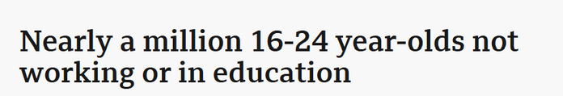




The landscape
has changed

Slide 5




How apprenticeships work?
Working full time
Studying part time
Work 4 days a week, 7 Hours a day, at a company in a team of professionals
Spend 1 day a week, 7 hours (20%) of your time studying
Earn up to £35,000 year whilst you are learning as a 1st year apprentice
Gain a real qualifaction with ZERO student debt
Build a network of like minded people who want to help you
Learn key skills off the job studying
you apply to work

Slide 6
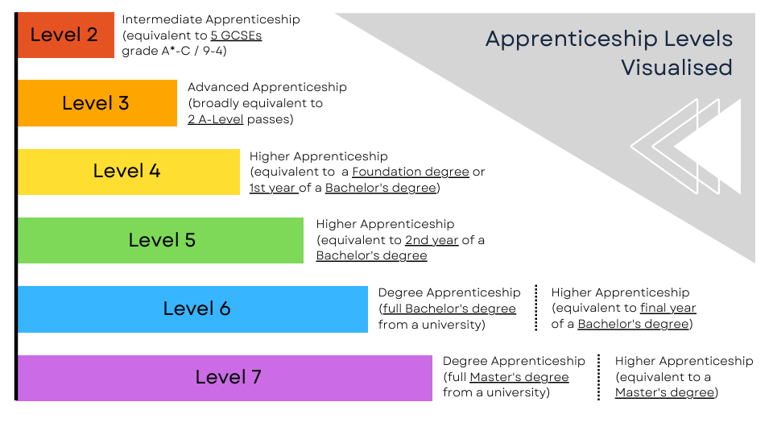

Slide 7
































1000s of companies offer apprenticeships
“STABLES” model. “S” Science, “T” Technology, “A” Accounting & Finance, “B” Business & Banking, “L” Legal, “E” Engineering & Construction, “S” Special Interests & “P” Public Sector” .
S:
L:
T:
E:
A:
S:
B:
P:

Slide 8
Things to consider
1) Do you know which career you'd like to get into?
2) Do you like the idea of working and studying?
3) Is having no student debt something that is important to you?
4) Is wanting to start your career now important to you?
5) Are you fine with missing out on the traditional university experience?
6) Are you a person who is really organised with their time?

Slide 9

Options after an apprenticeship
1) Further Study
Pursue a higher-level apprenticeship
or a professional certification
to boost your skills and earnings.
2) Career Break
Travel, volunteer, or pursue other interests, often using flexible arrangements like Sabbatical to keep your current job open.
3) Land A Job
Secure a permanent role at your
current company, or leverage your
transferable skills to join a new one.
4) Start A Business
Use your new practical insights and savings
to become an entrepreneur or
scale your side-hustle full-time.

Slide 10

So what now

Slide 11
APPRENTAGO
Lesson Guide 2
Your Unfair Advantage (How Apprentago Works)

Slide 12
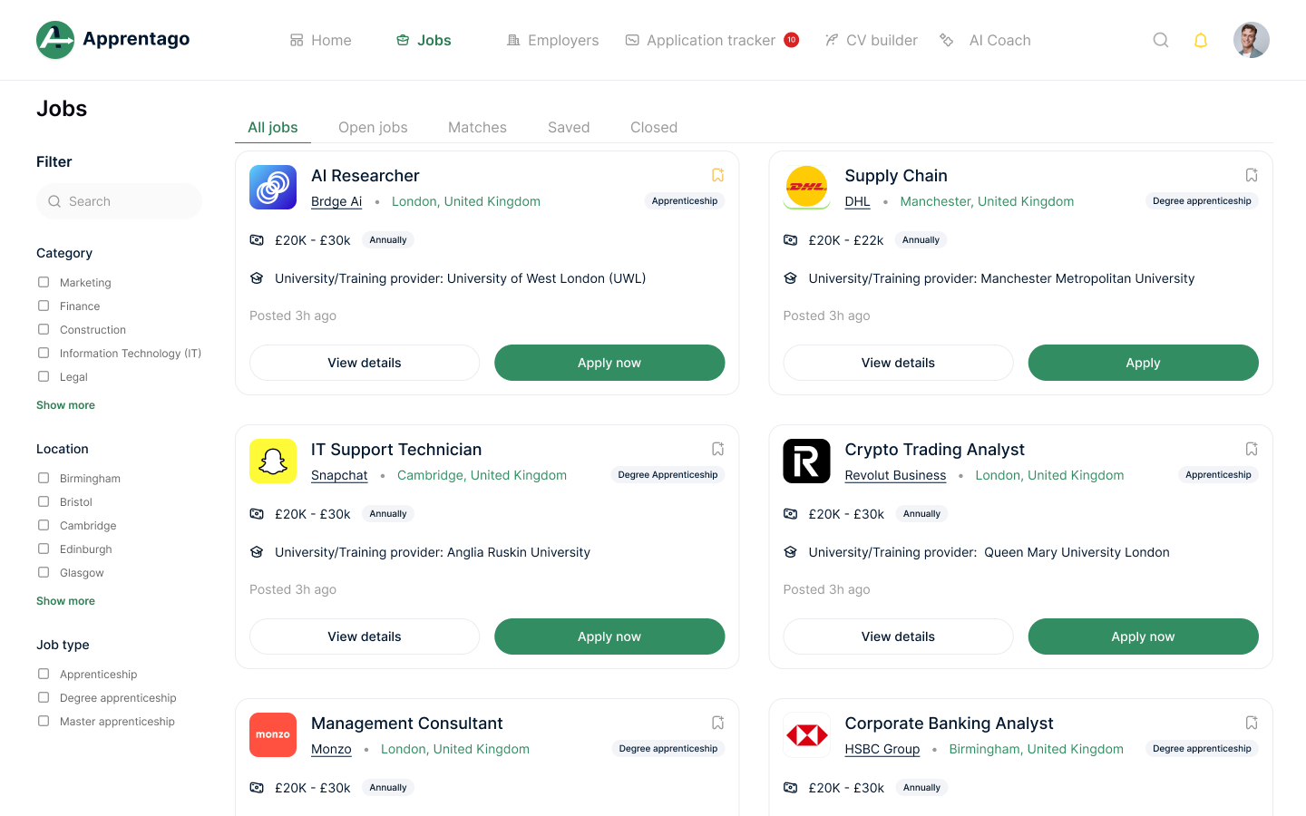
Apprentago Jobs Page
  Access thousands of live apprenticeships right now.
  Filter roles from Level 2 up to Degree level, with over 15 categories to choose from.
  The platform is updated with new roles every single hour.

Slide 13
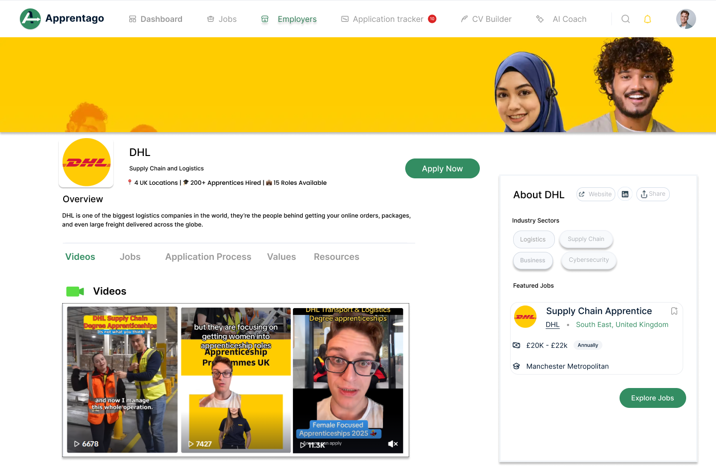
Apprentago Company Profiles
  Explore company culture, values, and the exact application process all in one place.
  Watch embedded TikTok videos to see what the workplace, team, and day-to-day role are like.
  Use this inside knowledge to prove your "Commercial Awareness" during your interviews.

Slide 14
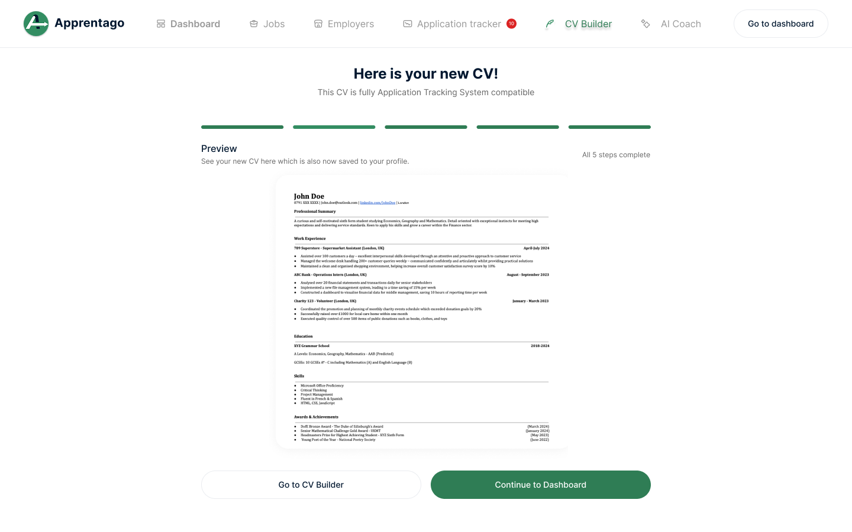
Apprentago CV Builder
  Every CV is made to be Application Tracking Systems (ATS) compatible formatting so your CV does not gets auto-rejected by a robot.
  Input your skills, education, and experience easily without worrying about messing up the design.
  The skills & postcode you put in your CV will automatically match you to live apprenticeships in your area.

Slide 15
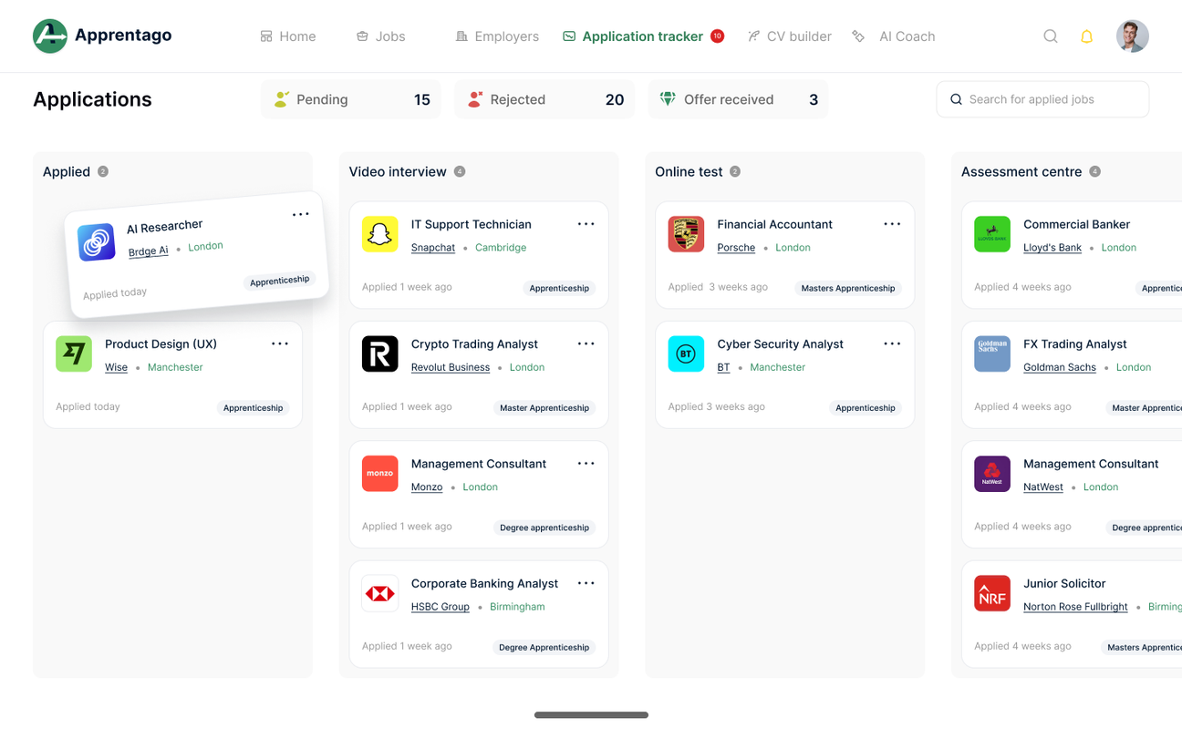
Apprentago Application Tracker
  Keep track of every single application in one central place so it doesn't get messy.
  Drag and drop your applications from "Applied" all the way to "Offer Received".
  See your deadlines instantly and use the note-taking features to save your company research.

Slide 16
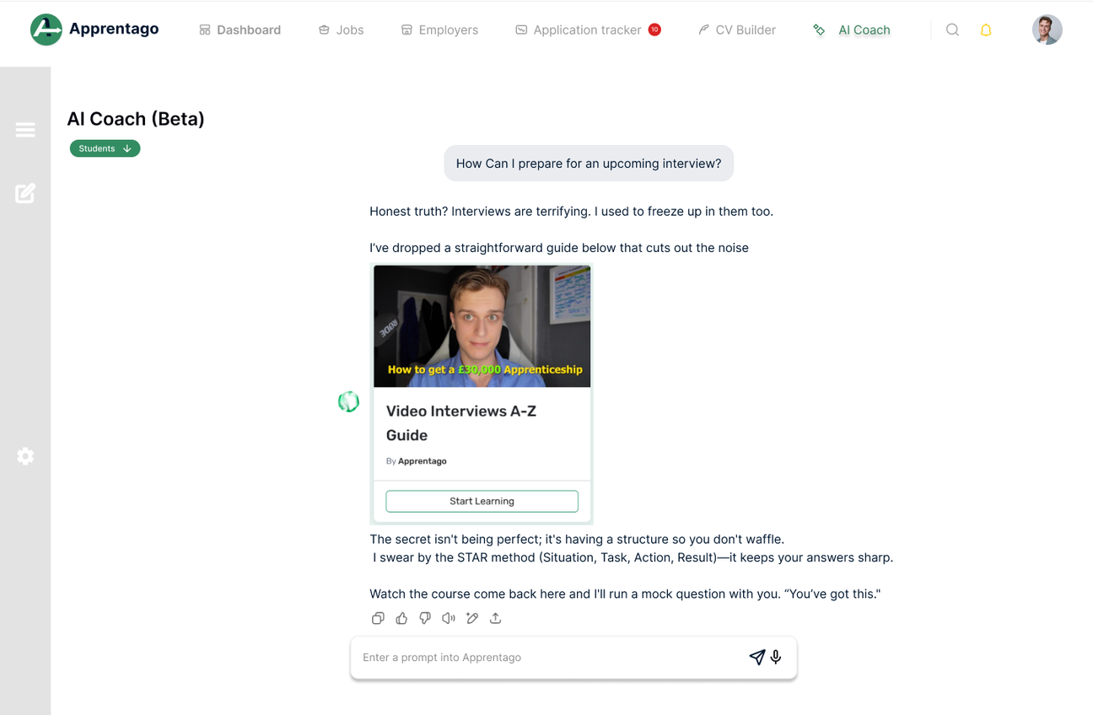
Apprentago AI Interview Coach
  Speak or type through mock interview questions in a safe, low-pressure way.
  The AI helps you structure your answers clearly and flags areas to improve.
  Practice as many times as you need so you feel fully prepared to speak with a real employer.

Slide 17
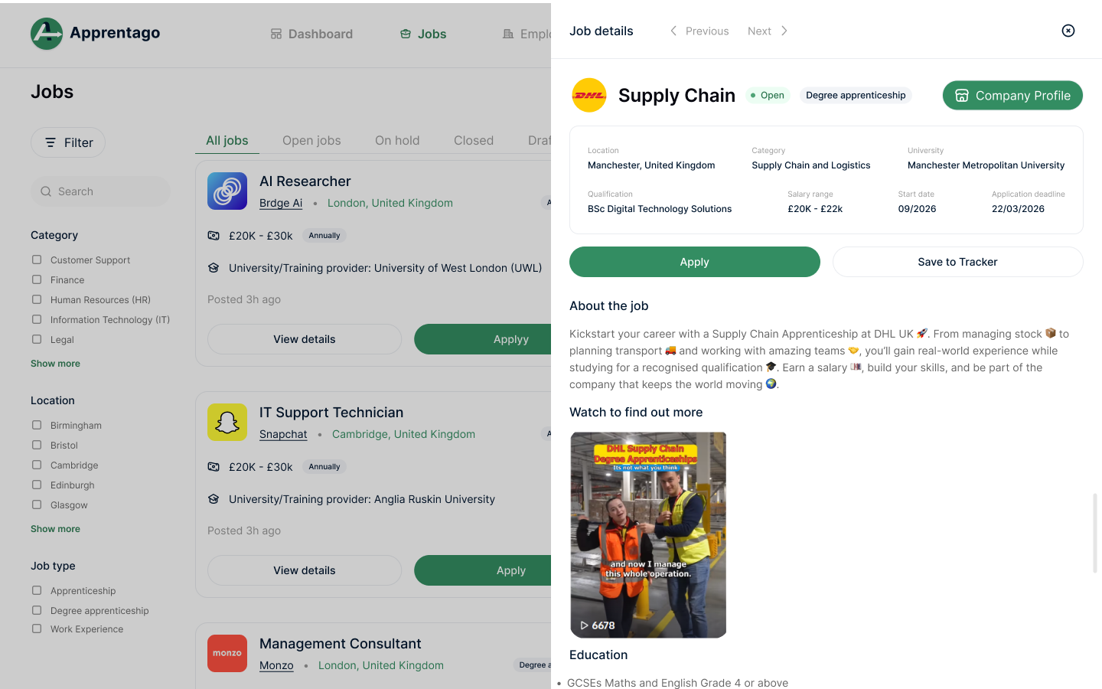

Your Turn (Take Action Today)
  Step 1: Head to Apprentago.co.uk on your school laptop, or at home tonight.
  Step 2: Filter the jobs page by the industry you are most interested in.
  Step 3: Find 3 apprenticeships you like and hit "Save" to add them to your Application Tracker!

Slide 18
APPRENTAGO
Lesson Guide 3
Researching A Company: Commercial Awarenes

Slide 19





Why You Must Research (Commercial Awareness)
1) What does the company actually do?
Go beyond the name. What products or services do they sell? Who are their customers? How do they make money?
2) The company’s mission and values
What does the company stand for? What problems are they trying to solve? Do their values align with yours?
3) Size and scale of the business
Look at how big the company is. Are they global or UK-based? How many employees do they have? Roughly how much revenue do they generate each year?
4) Their clients, products, or portfolio
Who do they work with? What industries are they involved in? What makes them different from their competitors?
6) Contacting Staff and Attending Events
Network (e.g. find and connect with current apprentices and employees via LinkedIn or speak to people you may already know)
5) Recent news or changes
Have they launched new products, expanded into new markets, merged with another company, or invested in new technology?

Slide 20

Case Study:
Bad Research
The Rolls-Royce Trap
Imagine walking into a Rolls-Royce interview and talking about your love for luxury cars! This is an instant rejection.
The Reality: Rolls-Royce Holdings PLC makes engines for aircraft, ships, and energy. Not cars! Lazy research proves you don't understand the business.

Slide 21

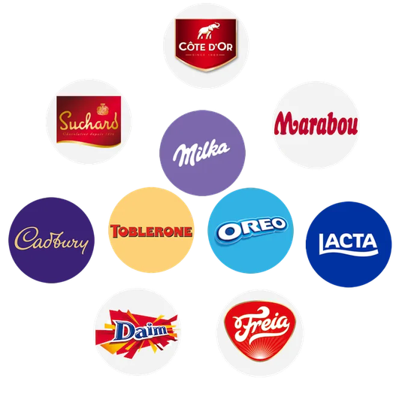
Case Study:
Good Research
The "Consumer" Answer (Bad):
"I want to work here because you make Cadbury and Oreo, you're global, and I love chocolate."
The Verdict: Shows basic awareness, but zero business understanding.
The "Professional" Answer (Good):
  "You operate in 150+ countries and generate £37 billion in revenue (5x more than Lindt)."
  "Your complex supply chain goes beyond chocolate into gum and beverages."
  "Your mission for sustainable cocoa sourcing aligns with my personal belief in fairness and equality."
Why it Wins:
You understand their scale, you know their competitors, and you linked their corporate mission directly back to your own values.

Slide 22



Ways to Research a company
  Apprentago Company Profiles: Watch embedded TikToks and read their values directly on the platform.
  LinkedIn: Search for current apprentices at that company and see what they post about.
  Google News / Annual Reports: Search the company name + "News" to find their latest projects or mergers.

Slide 23
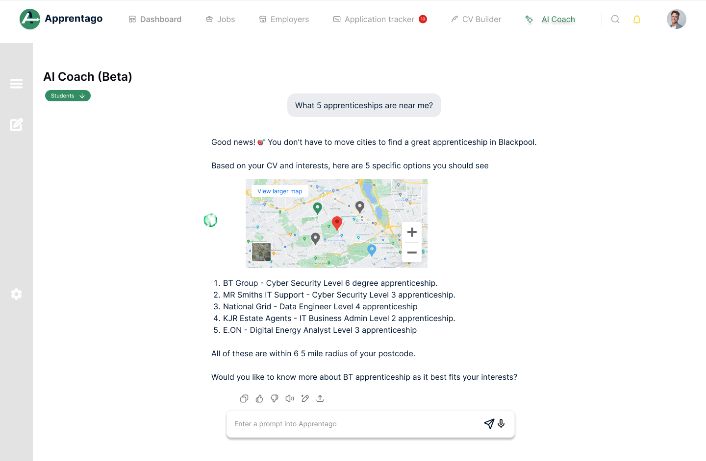
Your Turn (Take Action Today)
  Step 1: Ask the AI. Log on to Apprentago and open the AI Chatbot. Tell it what you enjoy, and let it generate a list of roles and employers for you.
  Step 2: Pick Your Target. Choose ONE employer from the AI's suggestions that excites you the most.
  Step 3: The 6-Box Deep Dive. Complete the "6 Boxes" of commercial awareness for that specific company. Bring your research to our next session!

Slide 24
APPRENTAGO
Lesson Guide 4
Application Process

Slide 25




Application Process
Step 1) CV (and Cover Letter)
Submit your basic details, CV, and a tailored cover letter.
Step 4) Assessment Centre
A series of group tasks/activities done with other applicants to further test your suitability for the apprenticeship role.
Step 5) Final Interview
An interview (e.g. face-to-face, telephone or video format). This can be combined with the assessment centre stage too.
Step 2) Online Video Interview:
Answer pre-recorded questions on camera so the employer can see your communication skills.
Step 3) Psychometric Tests
Complete timed online assessments testing your logic, skills, and behaviors.
Step 6) Await Decision
The final wait before you hear back on the company's decision to make you an apprenticeship offer.

Slide 26

Online Video Interviews
Beating the AI Screening
Many first-stage interviews are pre-recorded and reviewed by AI algorithms or busy recruiters.
  Eye Contact: Look directly at the camera lens, not the screen.
  Lighting: Ensure your face is clearly lit from the front, not silhouetted.
  Attire: Dress as if you are in the office. First impressions are visual
  Practice: Use the Apprentago AI Coach to best prepare

Slide 27



Psychometric Tests
Numerical
Verbal
Logical
Testing your ability to read charts, graphs, and calculate data under pressure.
Identifying logic and key information within complex written passages.
Pattern recognition and spatial reasoning to find sequences.
SECRET TIP: The difficulty isn't the questions, it's the clock. Read the Apprentago Ebook for more tips and tricks.

Slide 28
Assessment Centres
1) Ice Breakers
Team activities designed to reveal your personality and how you interact with others.
2) Group Tasks
Solving a business challenge in a team. Pro Tip: Volunteer as the Time-Keeper!
3) Presentations
Showing your communication skills by presenting a solution or research topic to the panel.
4) Case Study
Analysing a set of data or a scenario to prove your logical thinking and problem-solving.

Slide 29
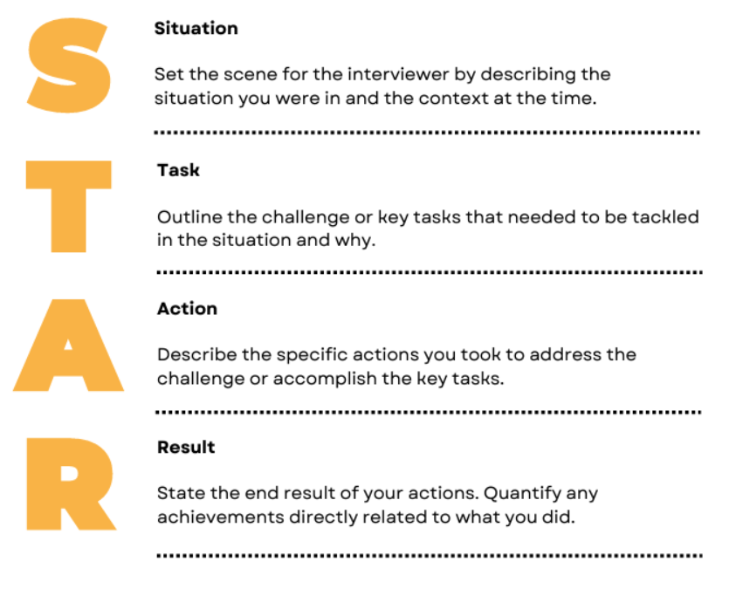
The STAR interview method
Use this structure for every interview question (Example: Tell me about a time when....)

Slide 30
The Final Mission
Step 1: The Research Deep-Dive. Log in tonight, pick your top saved apprenticeship, and complete the "6 Boxes" of commercial awareness.
Step 2: Beat the AI. Open your AI Interview Coach. Practice one STAR method answer based on your research until you score a 90% or higher.
Step 3: Secure Your Future. Use the Smart CV Builder to finalise your profile and submit your first application.
http://www.apprentago.co.uk

